Slide 1


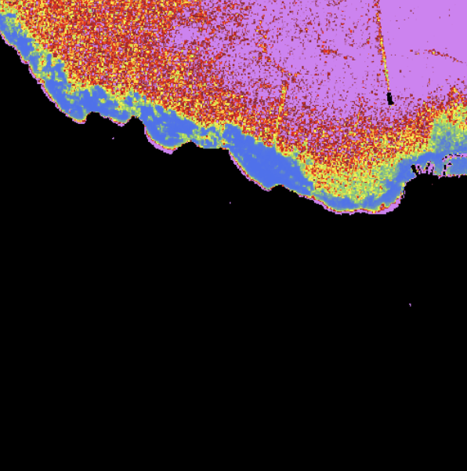


Cassini Hackathon Impact hub Athens

Slide 2

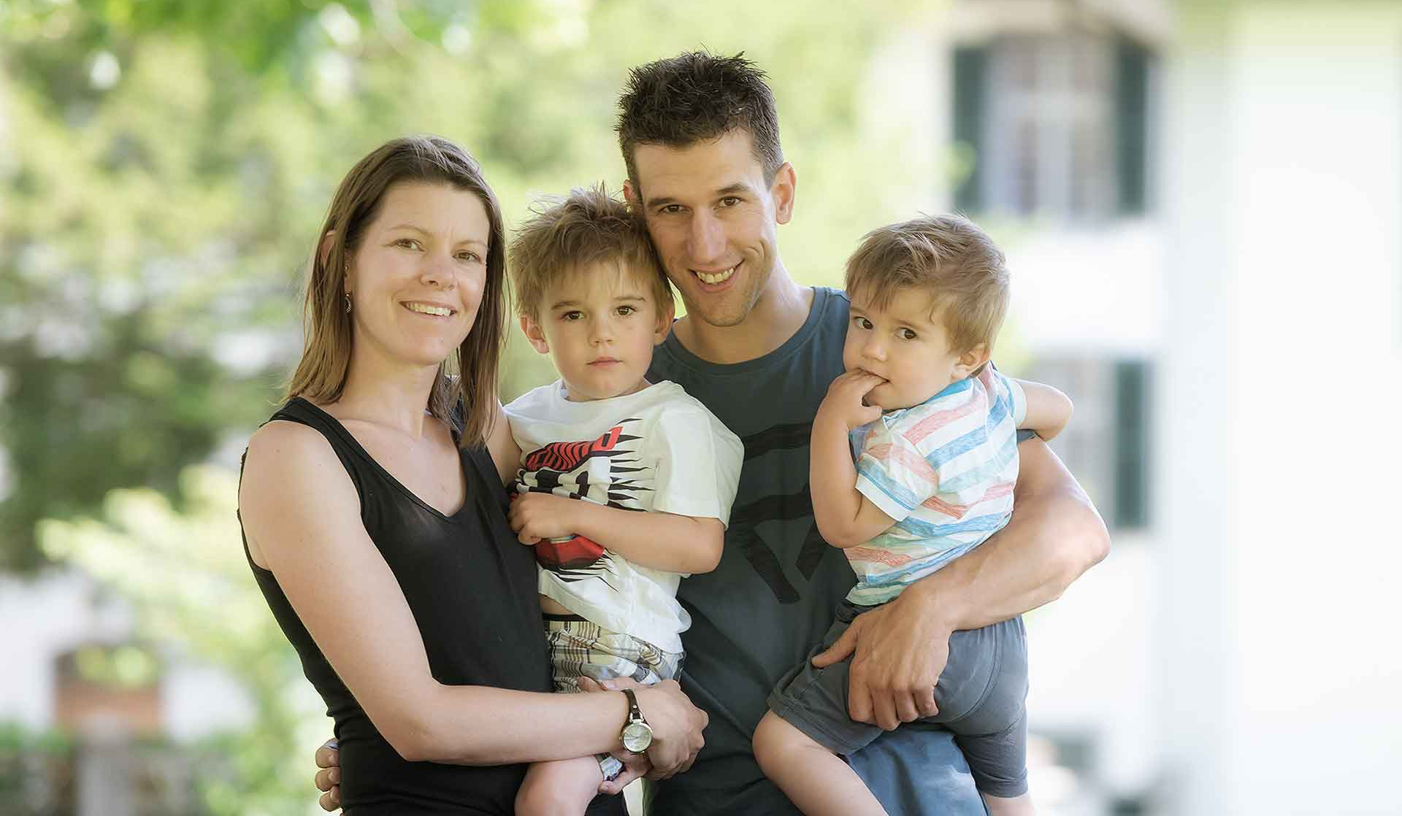
Solution
Problem

Slide 3

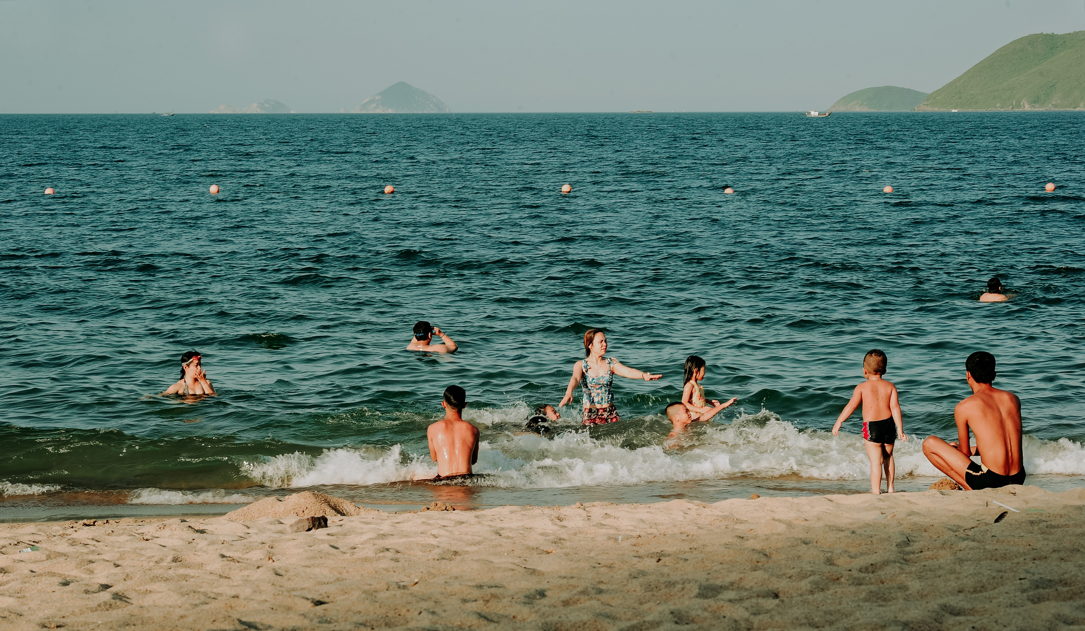
Solution
Problem

Slide 4
Solution
Problem
Family
Vacation

Slide 5


Solution
Problem
Unsafe swimming
spots
Tourists
Health risk
(Infections)

Slide 6
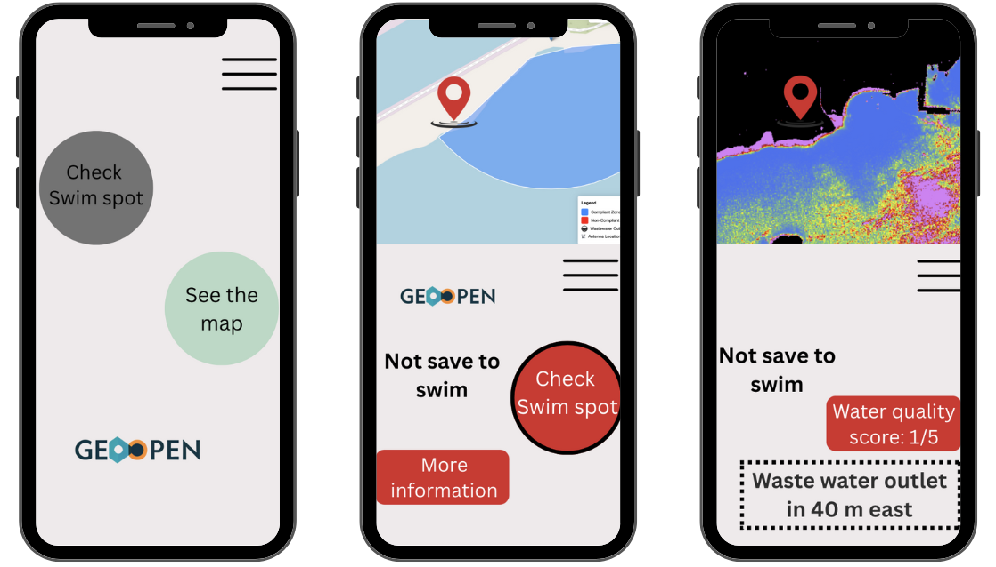

Solution
Dummy

Slide 7
Solution
Dummy

Slide 8
Solution
Dummy

Slide 9
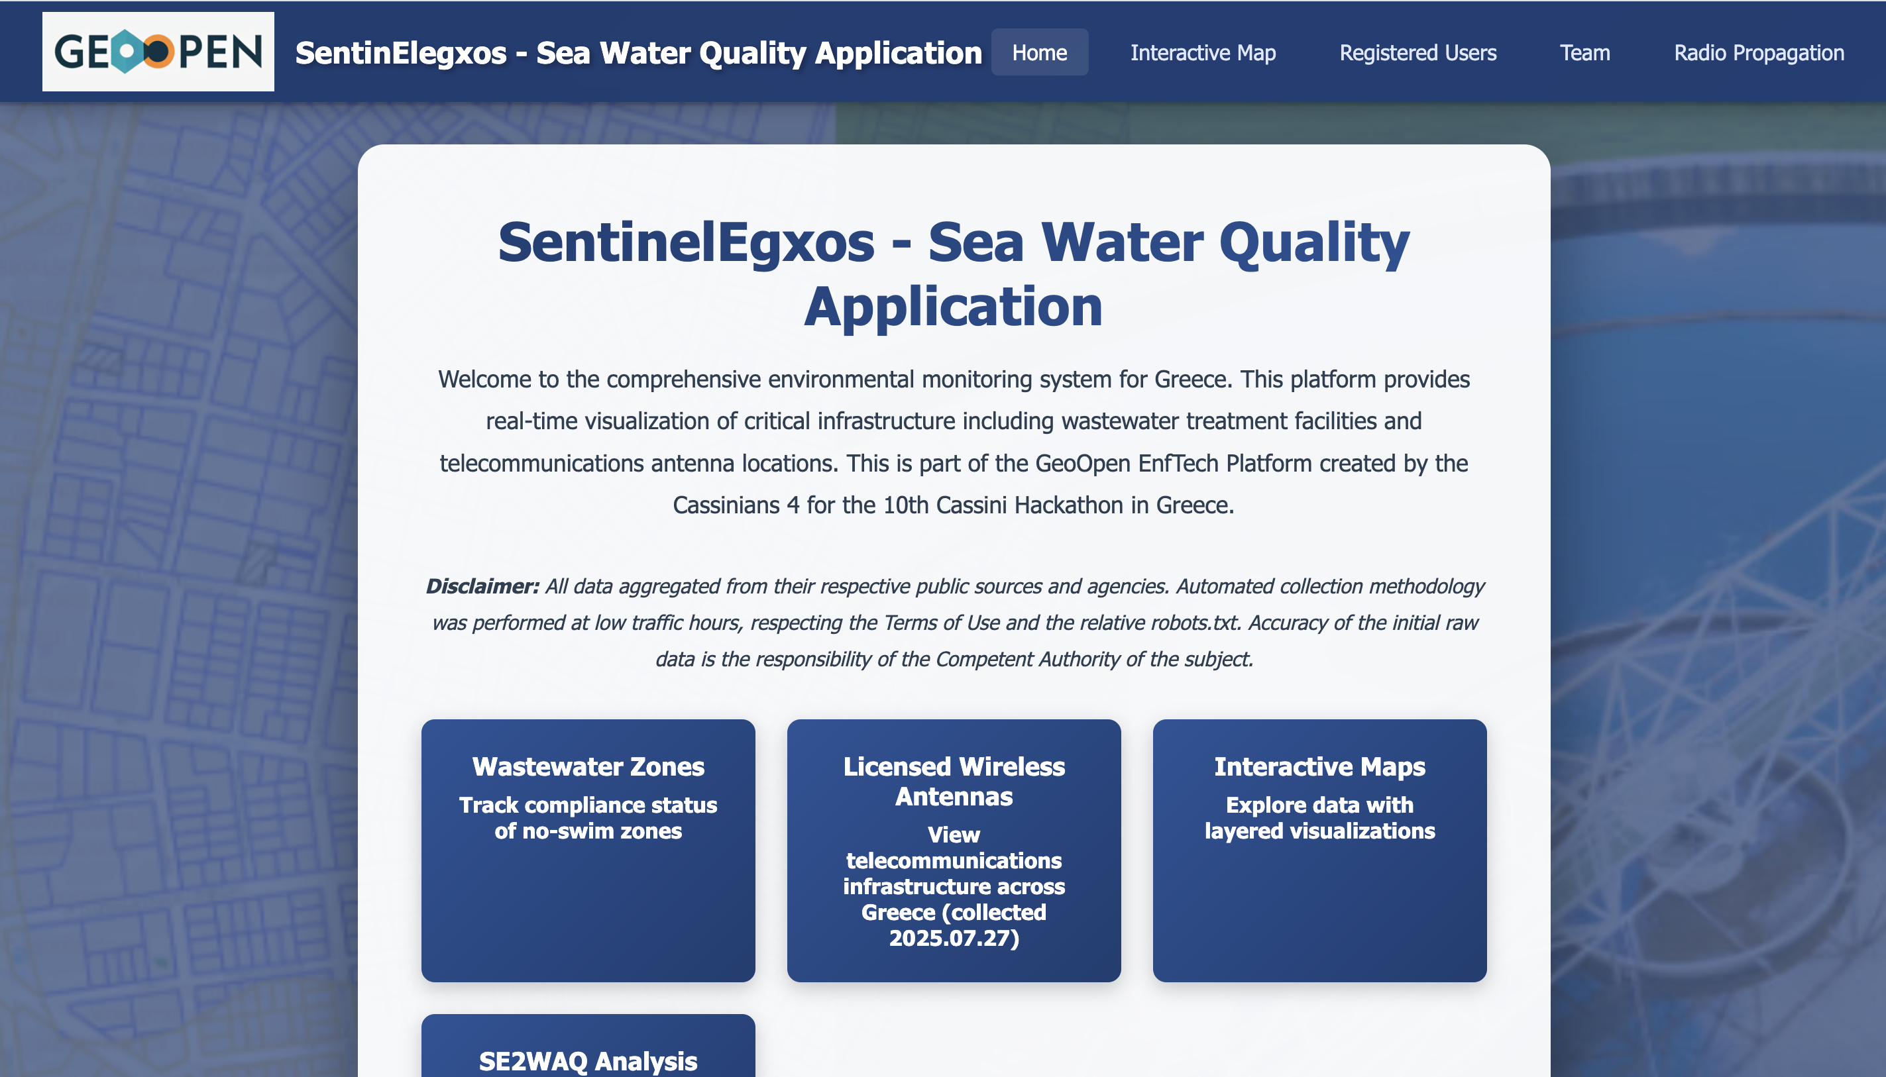
Solution
Demo

Slide 10
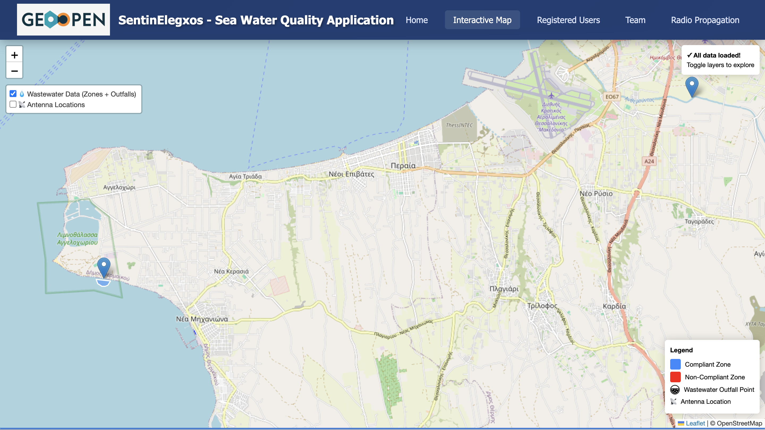
Solution
Demo

Slide 11
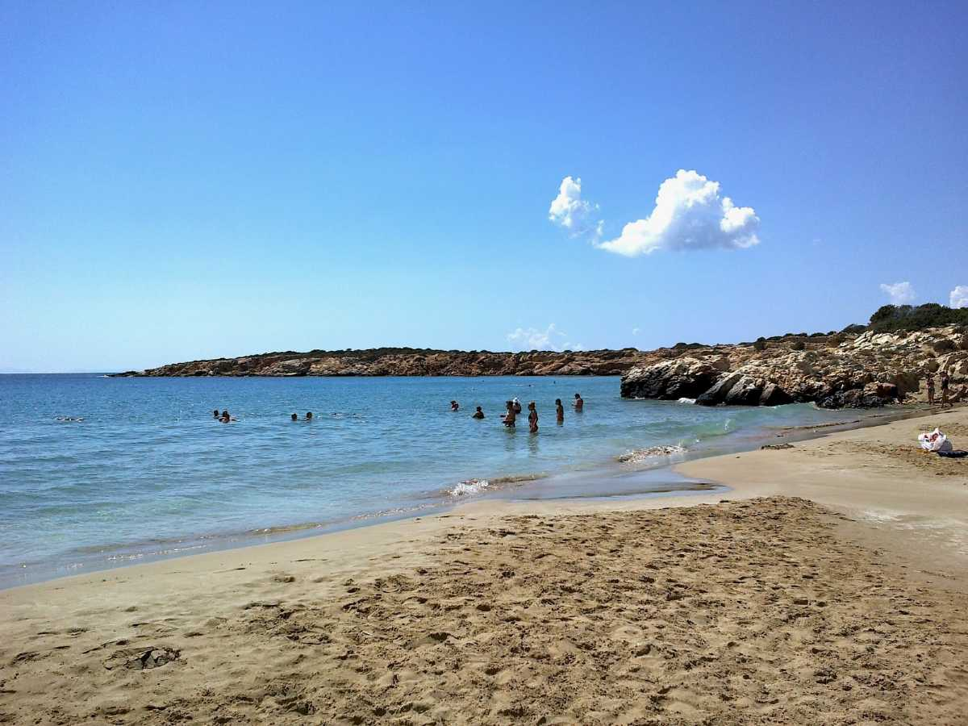
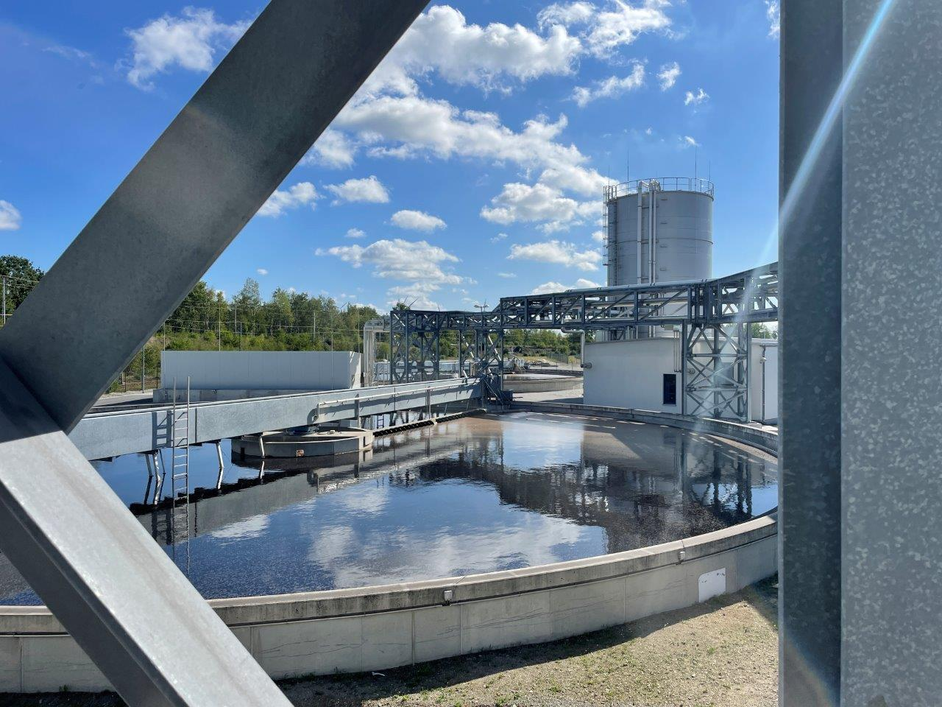


Impact
Safe swimming
Better water monitoring
Safe swimming (less health consequences) → For tourists / citizens
Less time for monitoring / find the hotspots → Authority
Can better monitor his water quality → Companies

Slide 12
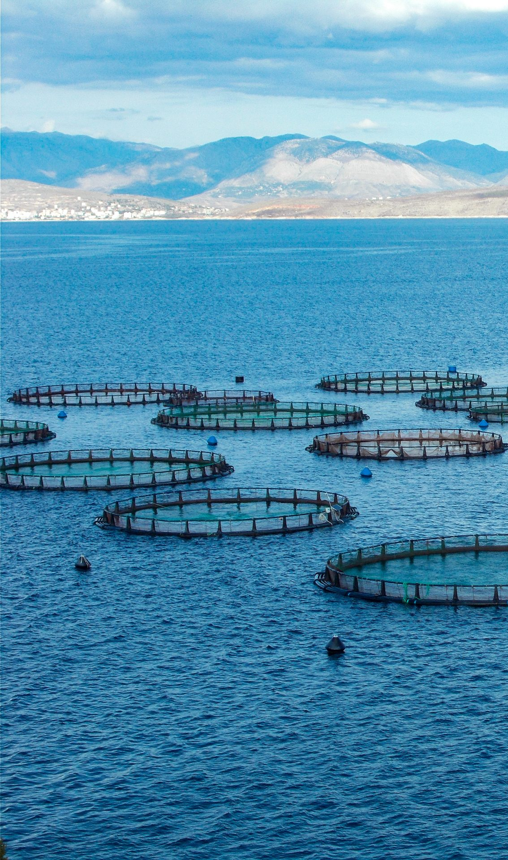


Impact
Safe swimming
Better water monitoring
Control from remote
Safe swimming (less health consequences) → For tourists / citizens
Less time for monitoring / find the hotspots → Authority
Can better monitor his water quality → Companies

Slide 13
Impact
Safe swimming
Better water monitoring
Control from remote
Safe swimming (less health consequences) → For tourists / citizens
Less time for monitoring / find the hotspots → Authority
Can better monitor his water quality → Companies

Slide 14









Techstack – How to use space data
Techstack
Filter

Slide 15
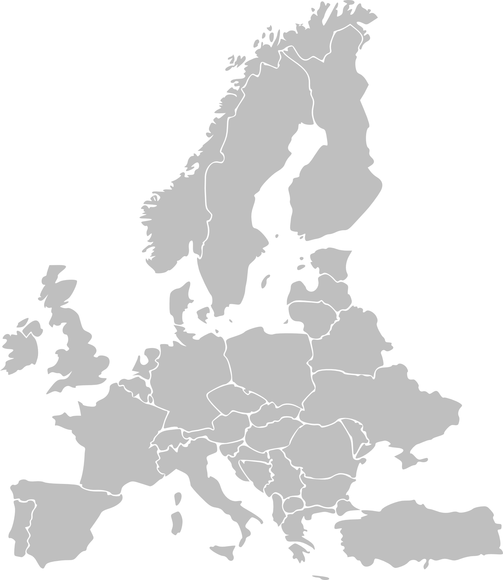



Next steps
Q4
2026
Q2
Q3
Cassini Hackathon
Pilot phase
Extend the tool
Launch
Add marinas & Fisheries
Other mediterenian countries

Slide 16
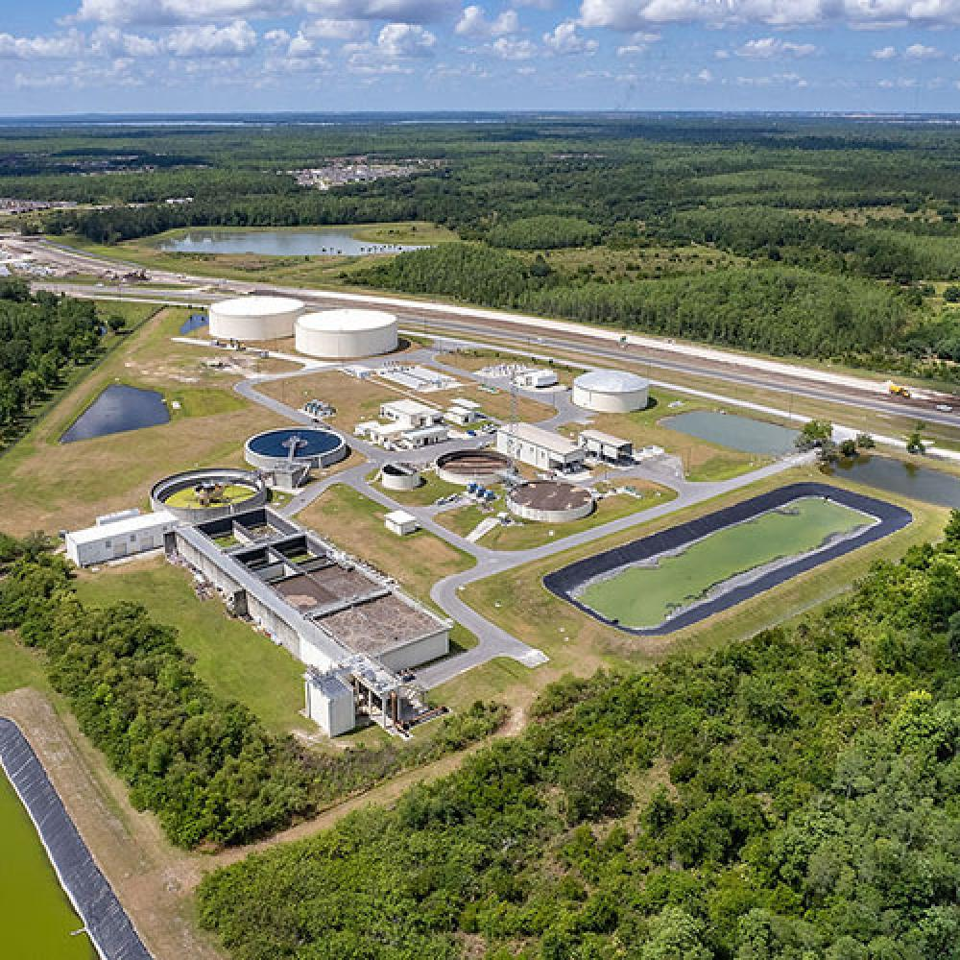
Next steps
Q4
2026
Q2
Q3
Cassini Hackathon
Pilot phase
Extend the tool
Launch
Add marinas & Fisheries
Other mediterenian countries

Slide 17
Cassini Hackathon
Pilot phase
Extend the tool
Launch
Business Plan
First year
Income
10,000 €
Costs/wages:
27,000 €
Income
20,000 €
Costs/wages:
24,000 €
Second year
Third year
Income:
80,000 €
Costs/wages:
50,000 €
Break Even point!

Slide 18
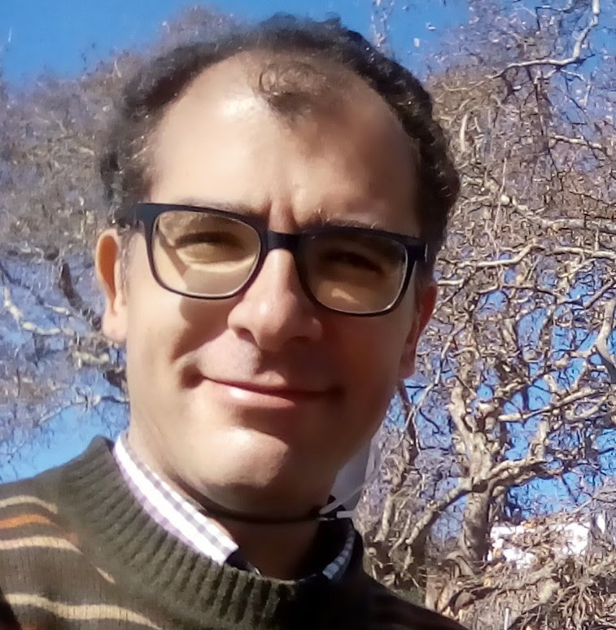
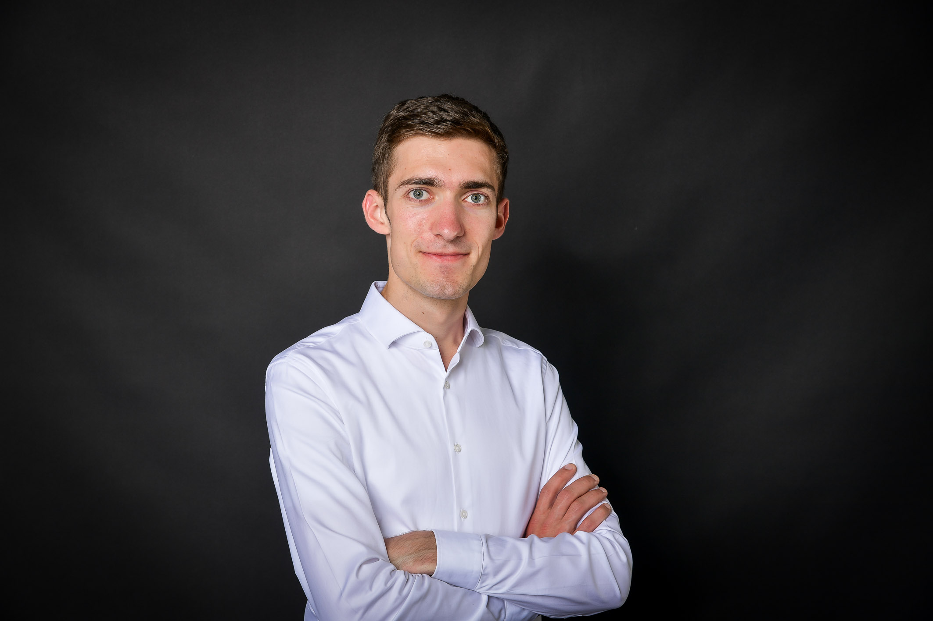
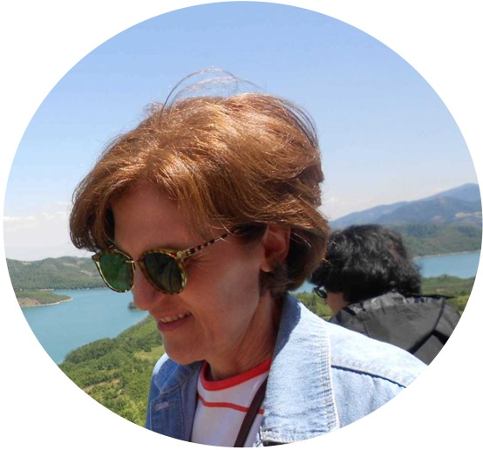



David
Smart city Engineer
Energy consultant
Student @NTUA
Team
Michalis
David
Ioanna
Founder
DevOps
Technical expert
Smart City Engineer
StartUp experience
Business expert
Chemist
Scientific advisor
Marketing expert
47 Years
24 Years
76 Years
3 Generation → One Vision

Slide 19
David
Smart city Engineer
Energy consultant
Student @NTUA
Thank you for your Attention!
3 Generation → One Vision

Slide 20
Solution
Solution
Public Authority
Marina / Companies
Compliance risk
Costly penalties
Time
Manual monitoring

Slide 21



Market research
1.5% of the EU’s bathing waters were of poor quality
280 Wastewater companies, water in sea
30 Million visitors every year

Slide 22
Business Plan
Category | Description | Cost (€) | %
Personnel | 2 part-time specialists (30 %) for 1 year | 16 000 € | 59 %
UI / UX Design | 1-month sprint by front-end engineer | 3 000 € | 11 %
Infrastructure | Hosting, Copernicus API, licenses | 3 000 € | 11 %
Marketing & Outreach | Web, demo events, stakeholder workshops | 5 000 € | 19 %
Total |  | 27 000 € | 100 %

